Slide 1
Python Programming Midterm Project
NYC Crimes Data Analysis
Samyak Meshram
Nidhi Berde
Pace University

Slide 2
Problem definition
To clean and perform Exploratory Data Analysis on the NYC Crimes dataset to form meaningful conclusions.
Cleaning the data, checking for null values, removing columns not necessary for analysis.
Using visualisations to determine insights about the data.

Slide 3
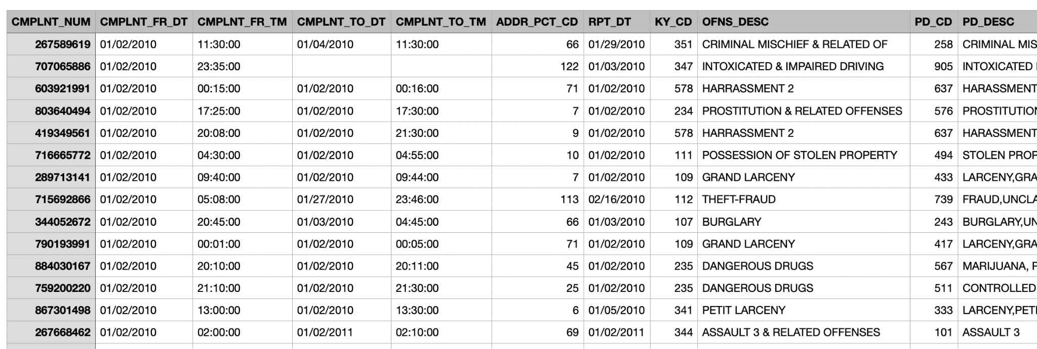
Dataset
This Dataset has been obtained from nycopendata.com
The dataset contains all the data from 10 years ( 2010-2021 )
The important columns that were used for analysis are Complaint start date, borough names, offense type, location, age groups.

Slide 4
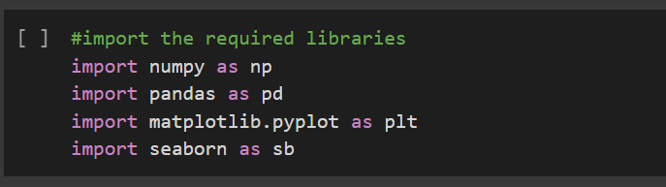
Importing Libraries
Numpy and pandas has been used for data preprocessing and matplotlib and seaborn for visualisations.

Slide 5
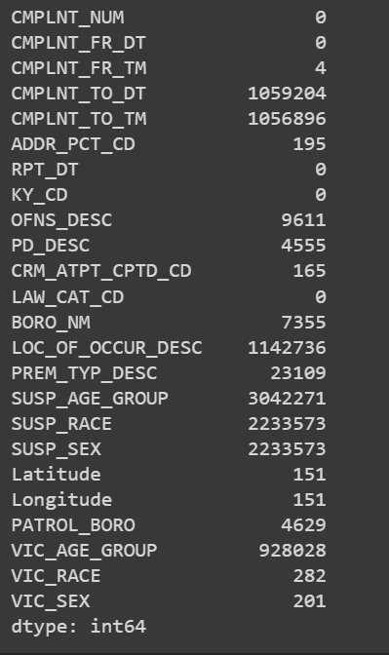

State of Data

Slide 6
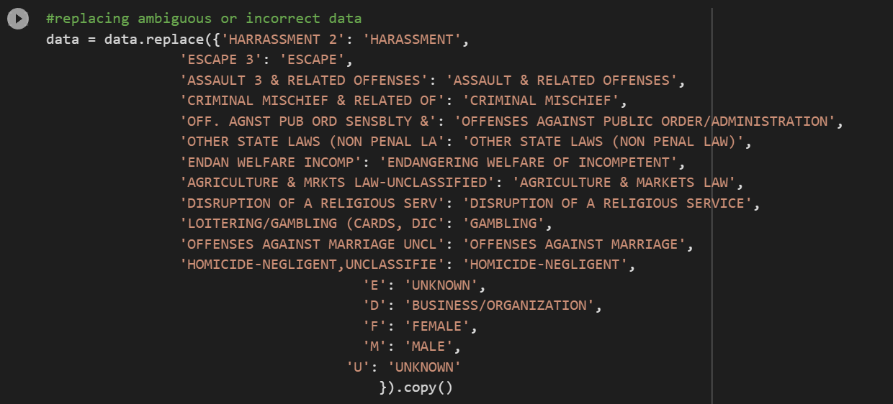
Replacing Data

Slide 7
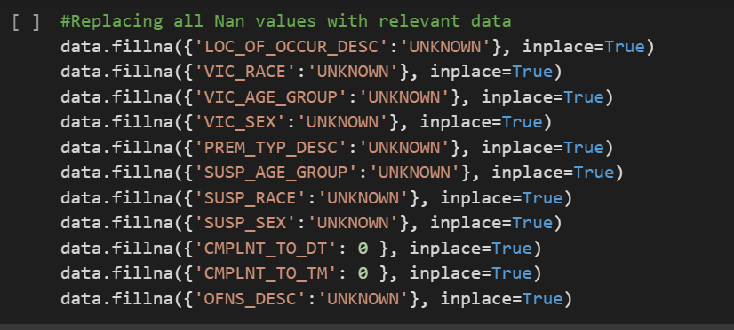
Filling null values with relevant data

Slide 8
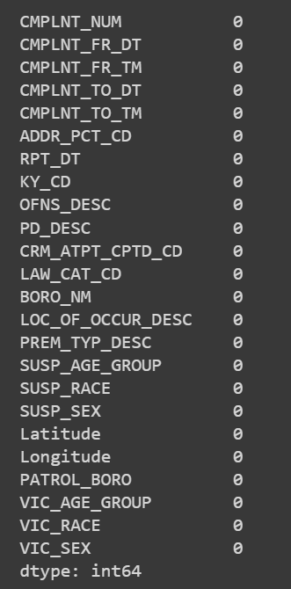

Cleaned Data :

Slide 9
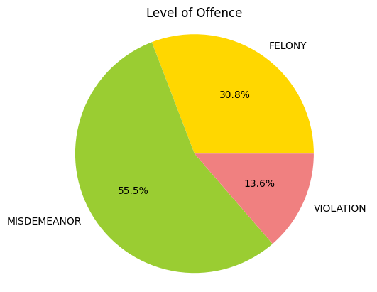
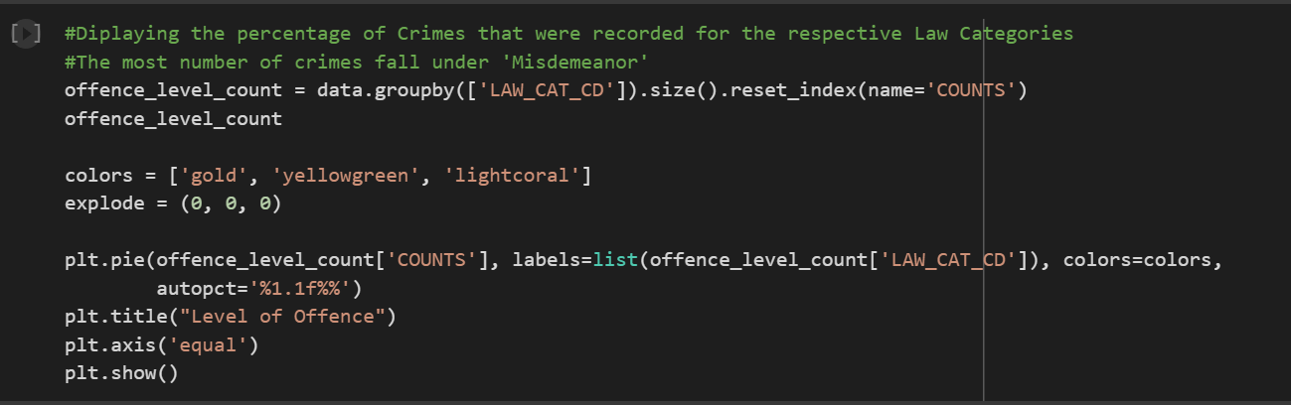
Crime Level analysis

Slide 10
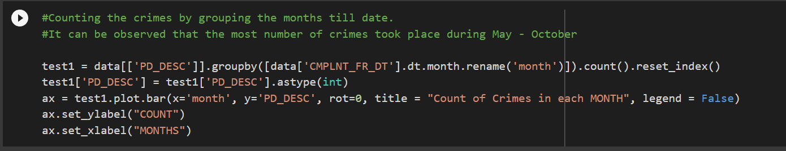
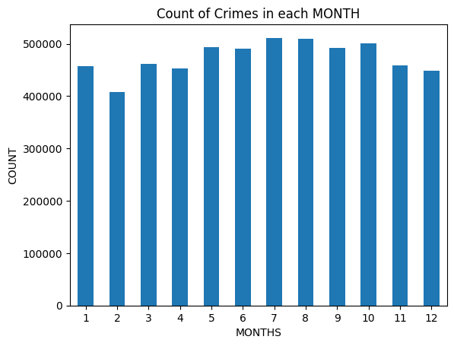
Crimes and months analysis

Slide 11
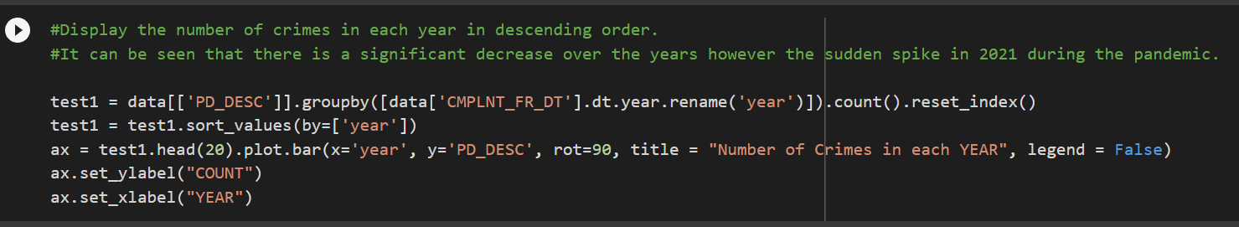
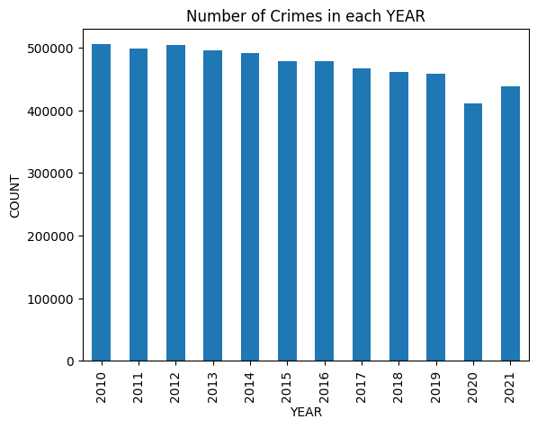
Crimes and Years analysis

Slide 12
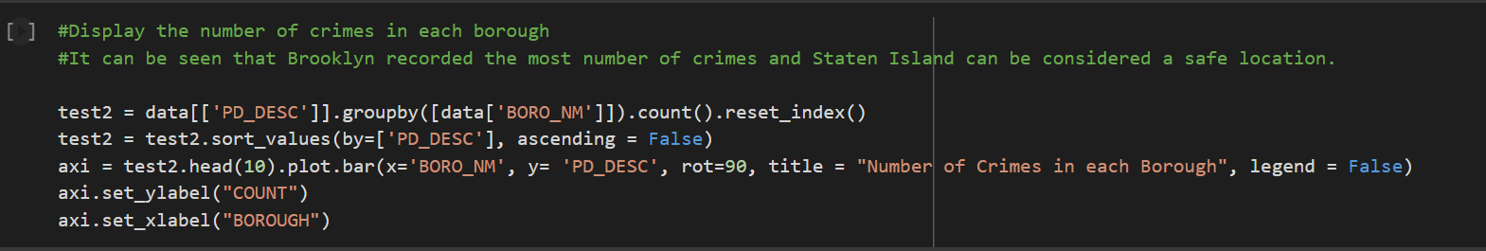
Crimes by Boroughs Analysis

Slide 13
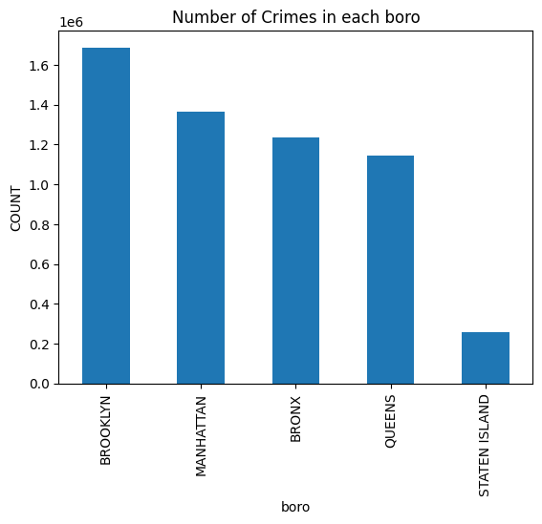
Crimes by Boroughs Analysis

Slide 14
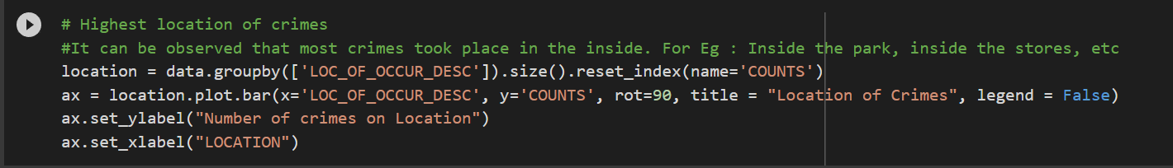
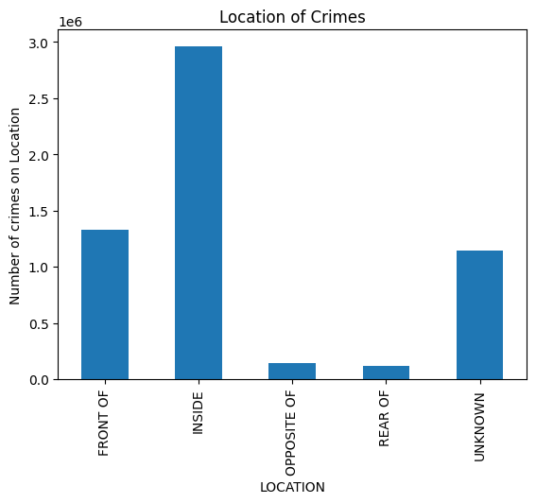
Location of Crimes

Slide 15
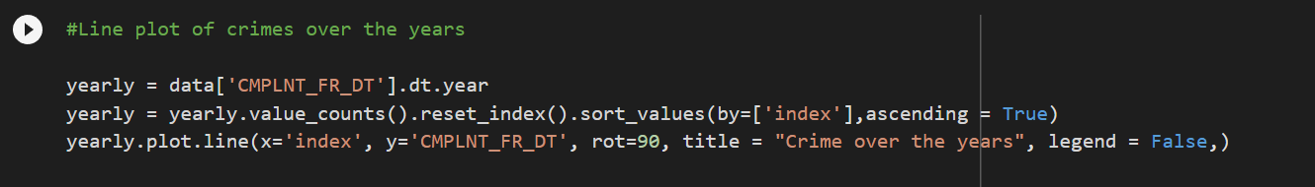
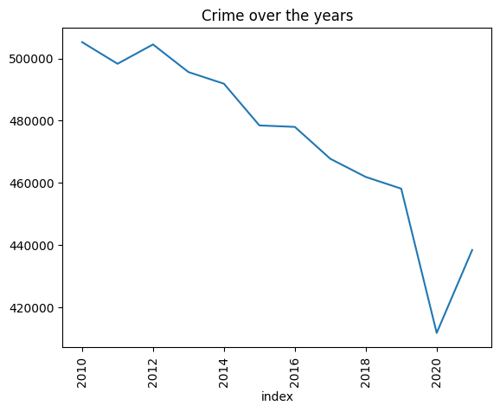
Crimes Over the years

Slide 16
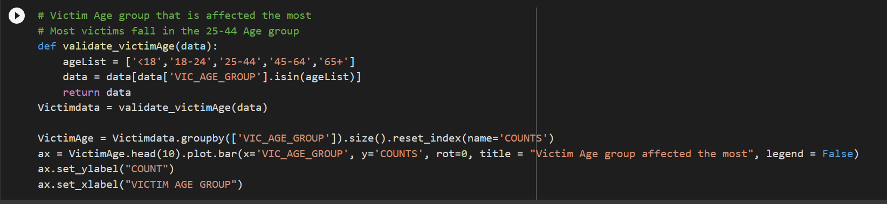
Victim Age Groups

Slide 17
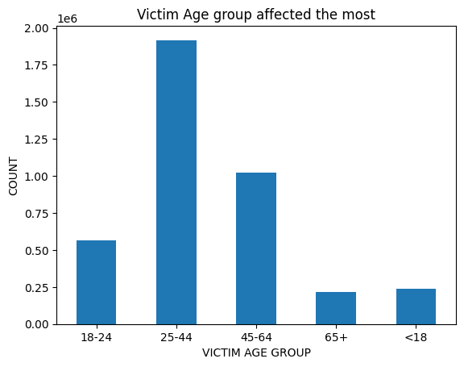

Slide 18
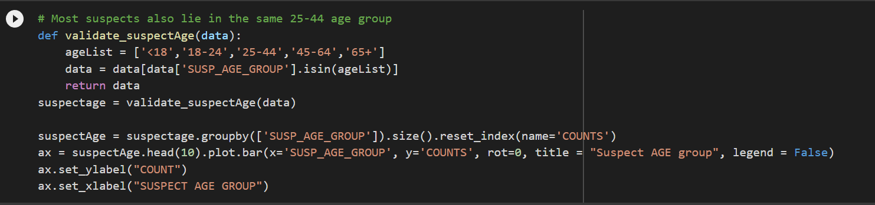
Suspect Age Group

Slide 19
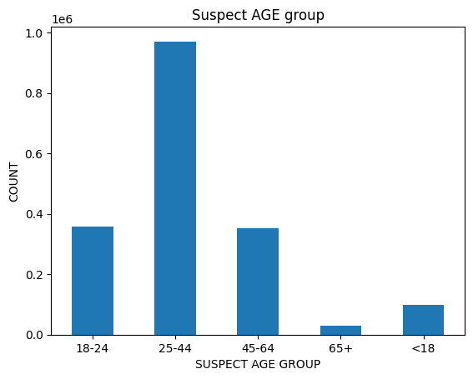

Slide 20
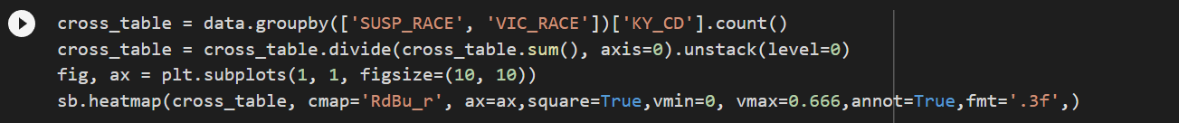
Correlation between suspect and Victim Races

Slide 21
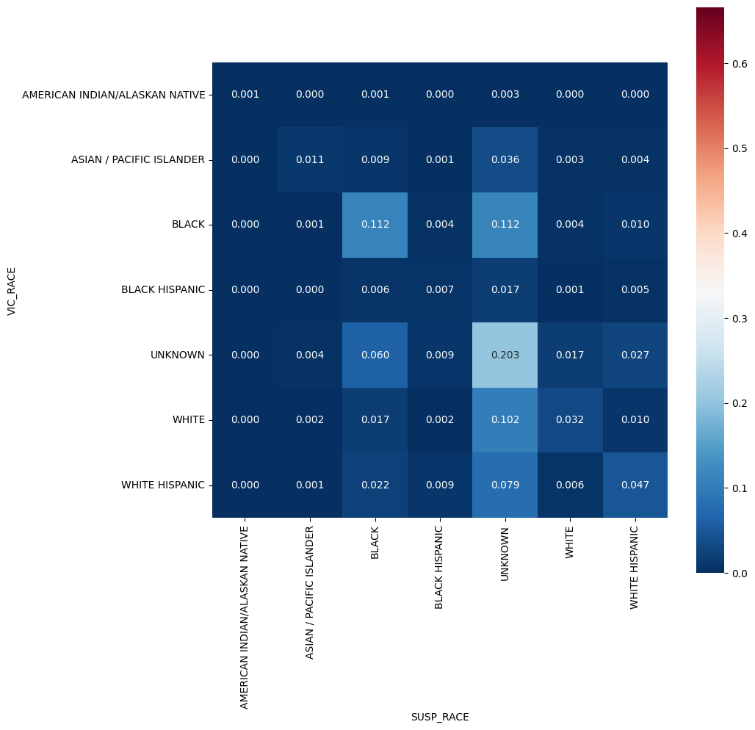

Slide 22

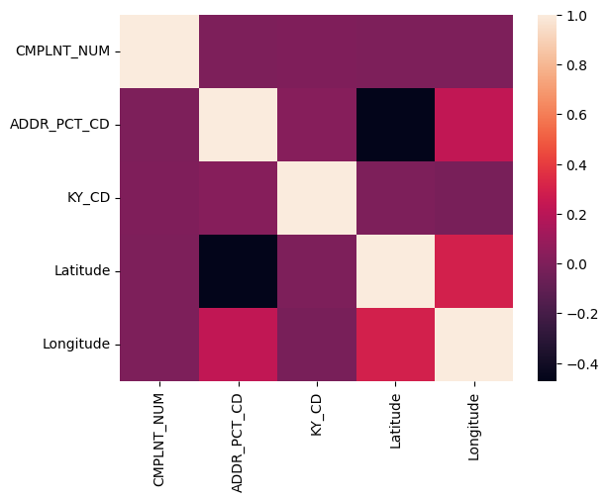
Correlation between data values

Slide 23
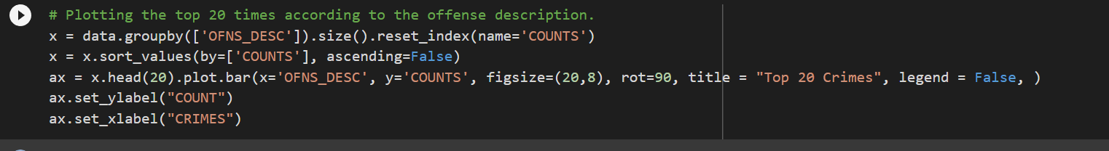
Top 20 Crimes

Slide 24
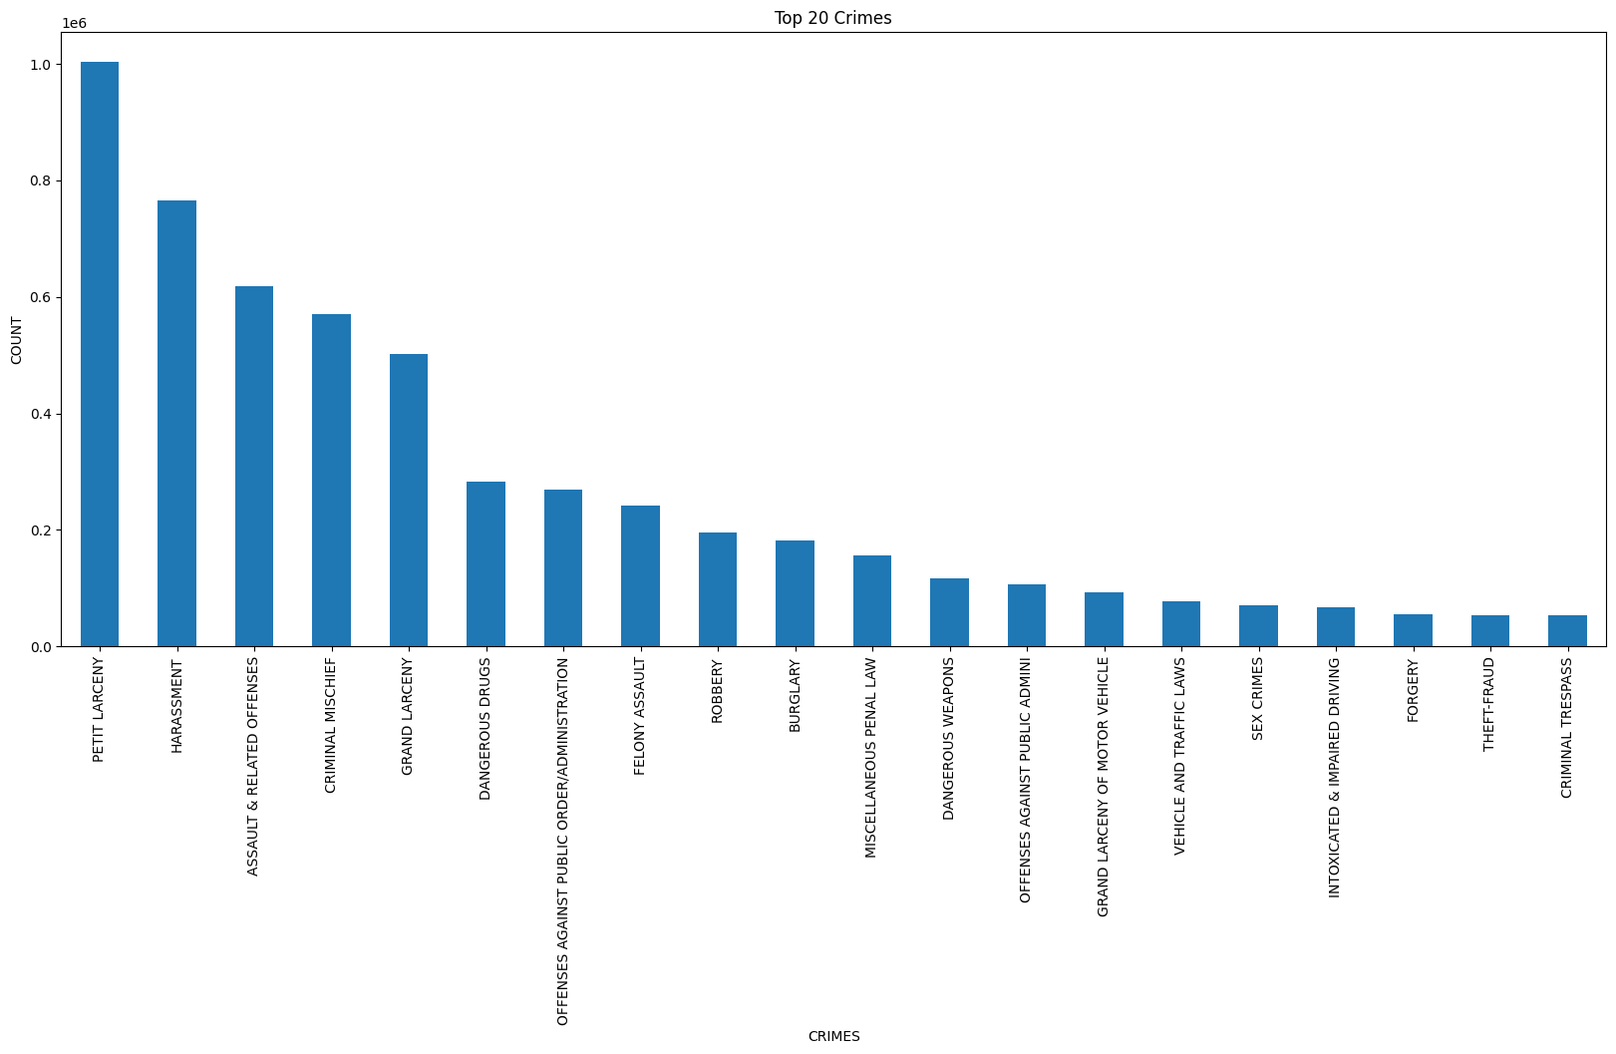

Slide 25
Thank you for watching

